Slide 1
Electricity
Basics

Slide 2
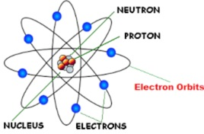
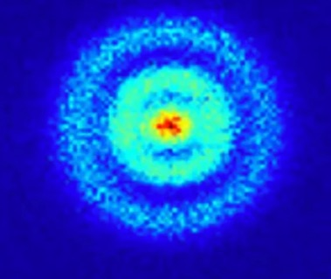
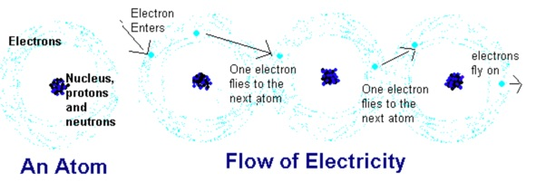
Electricity
Everything is made out of atoms.
Atoms are made out of Protons and Neutrons in the “center” or Nucleus. Protons are Positively Charged. Electrons are Negatively Charged
Electrons are located in the “electron cloud”
https://www.youtube.com/watch?v=FMlZq9NG_lo
Electricity is the flow of electrons from atom to atom
Image of H atom
Notes:
https://io9.gizmodo.com/the-first-image-ever-of-a-hydrogen-atoms-orbital-struc-509684901

Slide 3
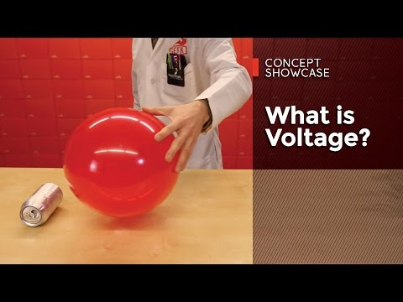
Electricity - Voltage
Notes:
https://learn.sparkfun.com/tutorials/voltage-current-resistance-and-ohms-law

Slide 4
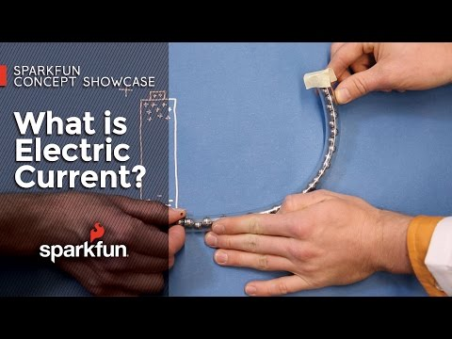
Electricity - Current
Notes:
https://learn.sparkfun.com/tutorials/voltage-current-resistance-and-ohms-law

Slide 5
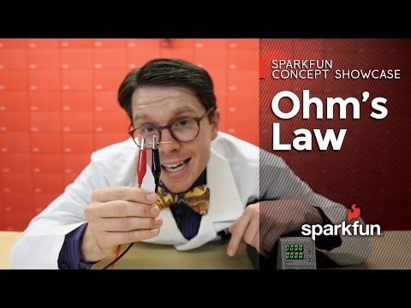
Electricity - Current
Notes:
https://learn.sparkfun.com/tutorials/voltage-current-resistance-and-ohms-law

Slide 6
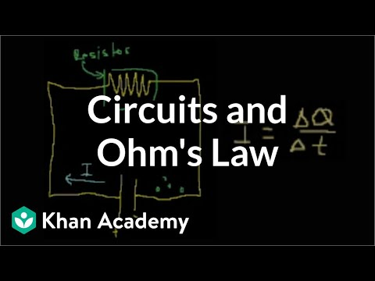
Electricity
Ohm’s Law
V = I R
Where
V - Voltage in volts
I - Current in amps
R - Resistance in ohms
P = V I
Where
P - Power in watts
Video for later

Slide 7
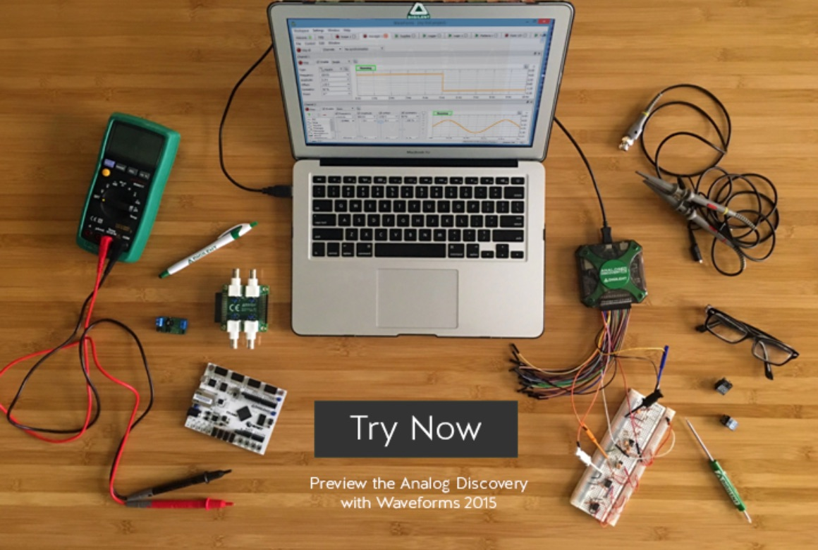
Analog Discovery 2 Demo

Slide 8
Demo
Breakboard - Use 10 ohm, ¼ watt resistor
V = 5V. What is I?
V = I*R
5 = I*10
5/10 = I
½ = I
What is P? V*I = 5*½ = 2.5W….more than resistor rating.

Slide 9
Demo
Let’s monitor the resistor with a thermocouple and IR gun.
Voltage | Current | Power | Temperature
1V | 0.1A | 0.1W
2V | 0.2A | 0.4W
5V | 0.5A | 2.5W

Slide 10
What just happened?
Rewrite the formula for Power using substitution:
I and R
What do you notice about the effect on power as you increase current (I)?
Power loss is often observed as heat
Notes:
P=VI
V= IR
P = IR*I = I2 R

Slide 11
Homework - Power
https://learn.sparkfun.com/tutorials/electric-power

